Slide 1
Project:
House Sales Price Prediction

Slide 2
Outline
Why accurate prediction is important?
Understanding Dataset features
Project problem statement
Tools Used
Approach Used to solve this problem.
Key Findings
Best Model and Result
Conclusions

Slide 3
Why Predicting houseprice is important?
Tackle overpriced
High price can be discouraging to potential buyers
Save buyers time.
Fast selling
Price transparency for buyer and seller.
Better negotiation.

Slide 4
Problem Statement
We need to build a model using Machine Learning in order to predict the actual value of the prospective.

Slide 5
Tools Used
Python
Libraries: Numpy, pandas, sklearn, scipy
ML regression algorithms
Anaconda and Jupyter notebook

Slide 6
Approach or Process Involved in Analysis
Exploratory data analysis
Feature Engineering
Relation between different features/amenities of house and target column i.e. sales price.
Correlation and identification of multicollinearity problem.
Identifying and Selecting best features that affect sales price.
Data pre-processing.
Model Initialization and evaluation.
Model Validation
Model Testing and Pipelining.
Prediction of test dataset values.

Slide 7
Understanding Dataset features
Columns in dataset: ['Id', 'MSSubClass', 'MSZoning', 'LotFrontage', 'LotArea', 'Street', 'Alley', 'LotShape', 'LandContour', 'Utilities', 'LotConfig', 'LandSlope', 'Neighborhood', 'Condition1', 'Condition2', 'BldgType', 'HouseStyle', 'OverallQual', 'OverallCond', 'YearBuilt', 'YearRemodAdd', 'RoofStyle', 'RoofMatl', 'Exterior1st', 'Exterior2nd', 'MasVnrType', 'MasVnrArea', 'ExterQual', 'ExterCond', 'Foundation', 'BsmtQual', 'BsmtCond', 'BsmtExposure', 'BsmtFinType1', 'BsmtFinSF1', 'BsmtFinType2', 'BsmtFinSF2', 'BsmtUnfSF', 'TotalBsmtSF', 'Heating', 'HeatingQC', 'CentralAir', 'Electrical', '1stFlrSF', '2ndFlrSF', 'LowQualFinSF', 'GrLivArea', 'BsmtFullBath', 'BsmtHalfBath', 'FullBath', 'HalfBath', 'BedroomAbvGr', 'KitchenAbvGr', 'KitchenQual', 'TotRmsAbvGrd', 'Functional', 'Fireplaces', 'FireplaceQu', 'GarageType', 'GarageYrBlt', 'GarageFinish', 'GarageCars', 'GarageArea', 'GarageQual', 'GarageCond', 'PavedDrive', 'WoodDeckSF', 'OpenPorchSF', 'EnclosedPorch', '3SsnPorch', 'ScreenPorch', 'PoolArea', 'PoolQC', 'Fence', 'MiscFeature', 'MiscVal', 'MoSold', 'YrSold', 'SaleType', 'SaleCondition', 'SalePrice']
We will do data analysis to find best features that have an affect on Sales Price of Houses.

Slide 8
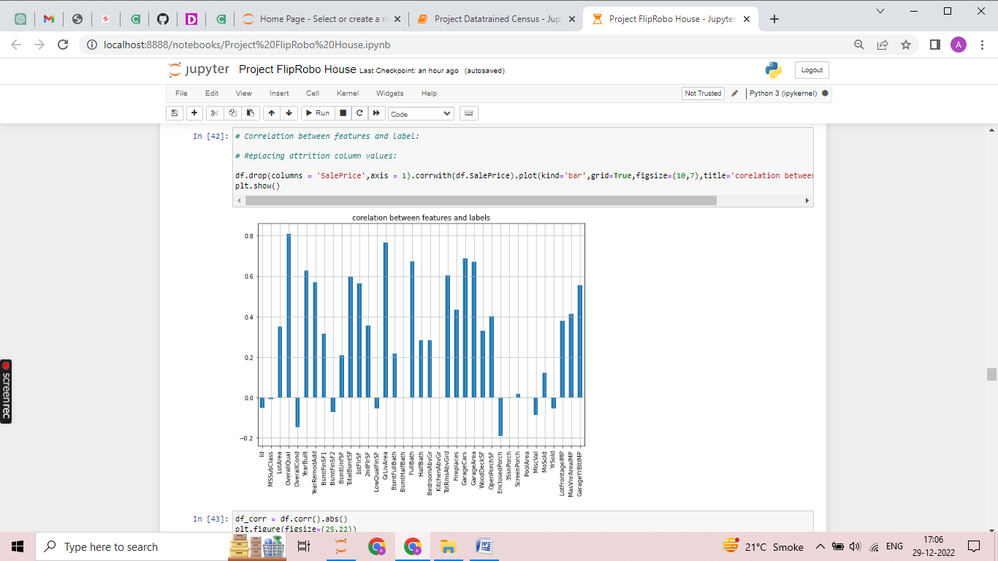
Key findings
Features positively related to Sales Price are indicated in graph:

Slide 9
Best Model and Result
Ridge regularization technique is the best technique for predicting sales price of houses with 91% testing accuracy and least error.
Ridge regularization for Regression algorithm with regularization techniques.
MAE: 13968.36639955988
MSE: 334826336.8224348
RMSE: 18298.260486243897
R2: 0.9121836752560588
Score: 0.997042314942911

Slide 10
Conclusion
Out of all regression algorithm used in this project:
Linear Regression
Ridge and Lasso regression
Decission Tree Regressor
Random Forest Regressor (with Hyperparameter tuning)
K-Neighbours Regressor (with Hyperparameter tuning)
Support Vector Regressor
AdaBoost Regressor (with Hyperparameter tuning)
Best model came out to be Ridge Regression model.
Result can be improved by following other approaches and Intense hyper parameter tuning.
Further, this model can be deployed to predict prices of Houses for different companies and locations and further can be used to elevate marketing strategies of real estate firms.

